Slide 1
SDSC 2005 - Introduction to Computational Social Science (Lecture 7)
Hao PENG
(haopeng@cityu.edu.hk)
Department of Data Science
City University of Hong Kong
https://haoopeng.github.io/

Slide 2
Agenda for this week
Online Communities and User Behavior
Participation, online norms
Adoption, retention, polarization
Community success

Slide 3
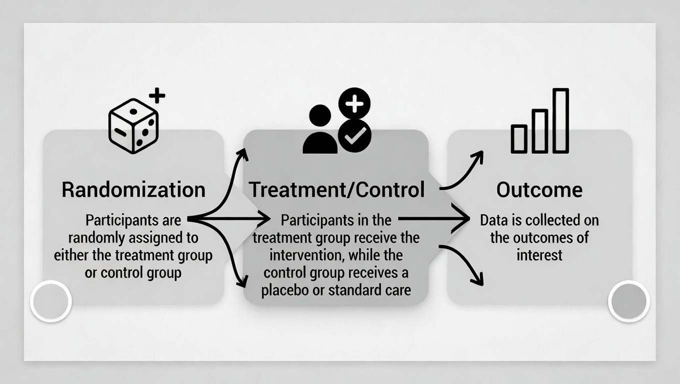
Experimental design
Weakness in observational design: unobserved confounds
Experimental strategy: Randomized controlled trial (RCT)
Gold standard for establishing causal claims
Random assignment (treatment vs. control group)
Balance on both observable and unobservable variables

Slide 4
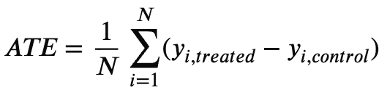
Quantifying effect size
Average treatment effect (ATE):
Compare the avg. outcome if everyone was treated vs. no one was.
Design: Two versions of the same CV, one CV assigned a Black-sounding name, the other assigned a White-sounding name. Recruit participants to rate the employability. Randomly assign participants into two groups.
With RCT design, we can simply calculate ATE by comparing the average outcome between treatment and control groups, why?
Notes:
Although only half of data is treated, …
Because each participant can belong to either group with equal chance, unlike the observational data where the treatment status (e.g. gender) is given.

Slide 5
Core elements of experiment
Clear hypothesis (IV and DV)
Pre-registered analysis plan (avoid “gaming” the exp)
Randomization (simple, stratified by demographics)
Treatment vs. control units (one or multiple stimulus)
Outcome measurement (pre/post or only post)
Power analysis (especially important with digital data)
To make sure the ATE is statistically different from 0
How much N do we need?
Notes:
One CV or many CVs

Slide 6
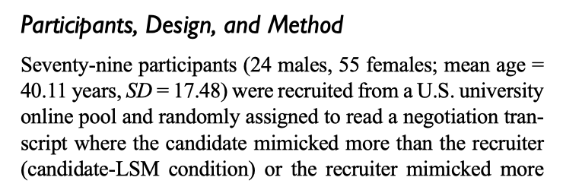
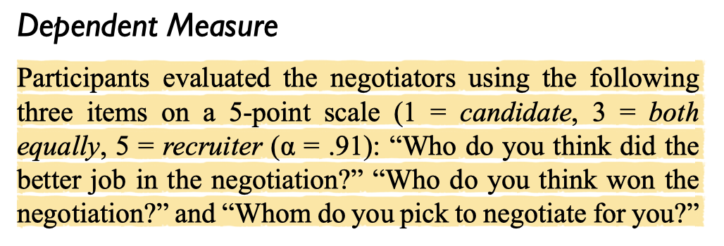
Lab experiment
Strengths:
replicable procedures, good internal validity
both IV and DV can be objectively measured
Weakness:
often conducted in an artificial setting, small N
only one (or a few) stimuli, lack of generalizability
lab env. is different from the real-world (e.g., different evaluators)
Romero et al. 2015. “Mimicry Is Presidential: Linguistic Style Matching in Presidential Debates and Improved Polling Numbers”
Notes:
Scholars vs. participants who are not trained to evaluator papers.

Slide 7
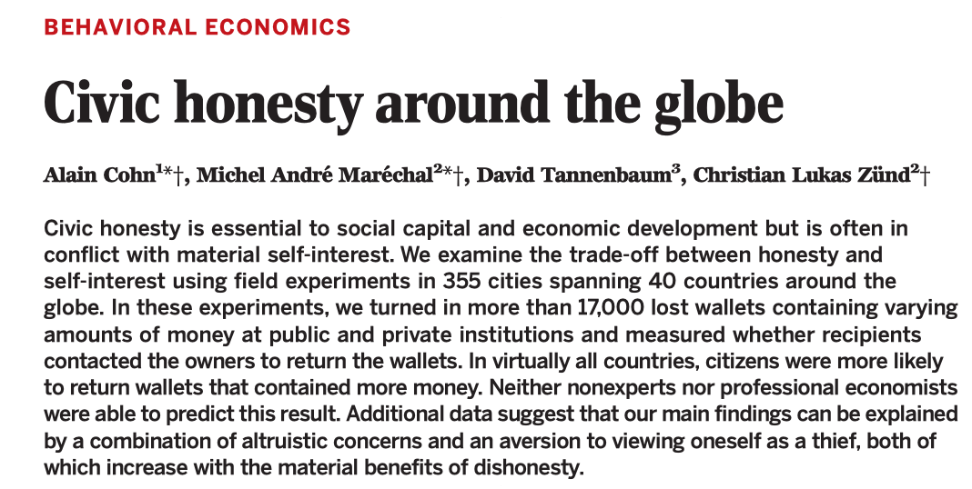
Field experiment
Manipulate an IV in a real-world, natural setting instead of artificial lab.
Strength: high external validity, participants act naturally, generalizable
Weakness:
confounds are harder to control, costly, and difficult to replicate
ethical challenges: can't practically test extreme/harmful conditions
How to do it in a lab setting?

Slide 8
Cost of experiment
Main sources of cost:
Staff time / salary
Participant reward
Solutions:
Automation (running experiment while you are taking a break)
Design enjoyable activities for participants in the experiment
In CSS: Can be done at unprecedented scale and low cost

Slide 9
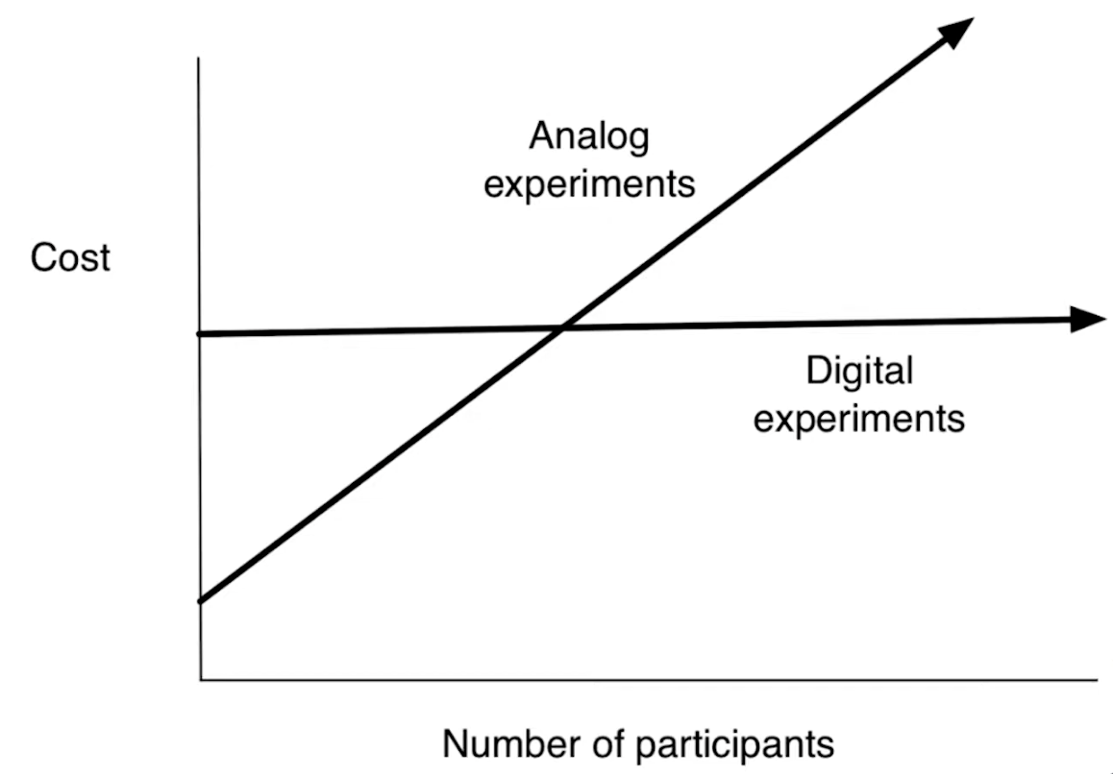
Digital/Online experiment
Recruit participants from online platforms (crowd sourcing)
Prolific, Amazon Mechanical Turk
Leverage platform infrastructure to automate the task online
Either commercial platform or build your own website
Zero-variable-cost Experiments
once the pipeline is built, adding more participants costs ~ nothing

Slide 10
Steps for digital experiments
Pre-register on OSF or similar sites
Ethical review (IRB at your institutions)
Choose platform
build your own site
Qualtrics, Prolific
Amazon Mechanical Turk, CloudResearch
Recruit / Randomize participants
Measure behavioral outcomes (clicks, downloads, shares)
Practice: How to A/B test different friend recommendation algorithms (strong vs. weak tie) on chance of finding new job.

Slide 11


Case study: how does social influence impact success of cultural products?
Hypothesis: Influence makes success unpredictable & unequal.
Ignored initially
Others get little attention
Notes:
Some famous books face initial rejections and are almost ignored at the beginning (hard to predict future success)
Majority of other songs receive little attention at all (unequal)

Slide 12
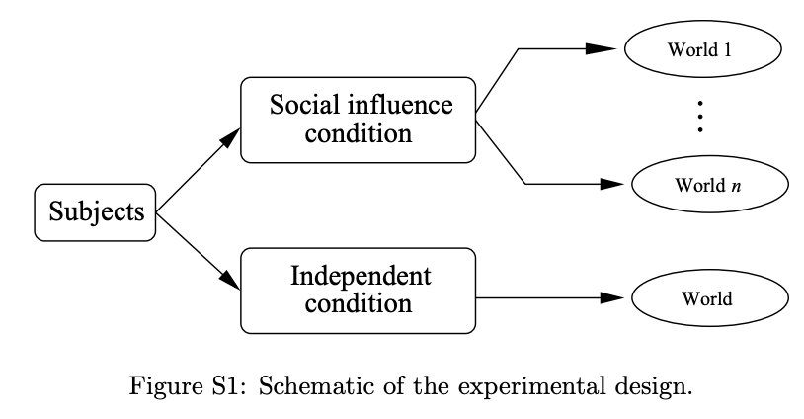
Music Lab Experiment
Classic study by [Salganik, Dodds & Watts, 2006, Science]
14,000+ participants, 48 unknown songs
(recruited from http://www.bolt. com, a website popular with young adults in the US)
Independent condition vs. 8 “social influence” worlds

Slide 13
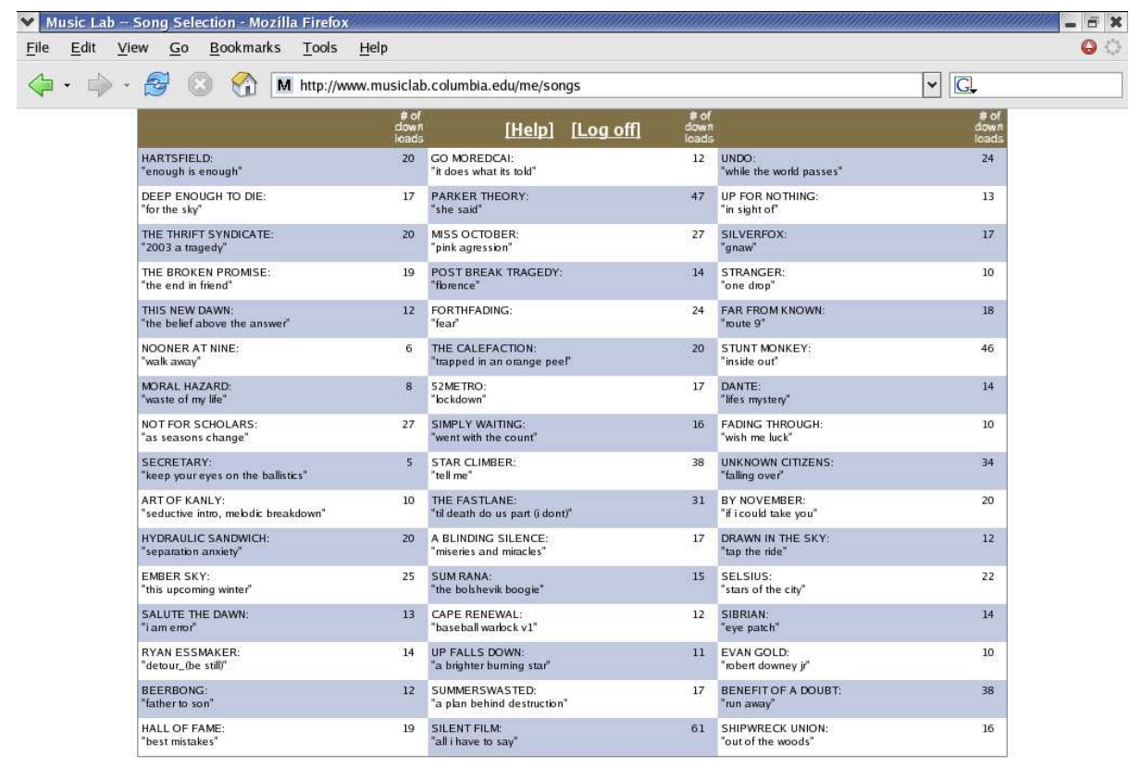
Music Lab interface / pipeline
“social influence” condition: download counts are shown
Independent condition: download information is hidden

Slide 14
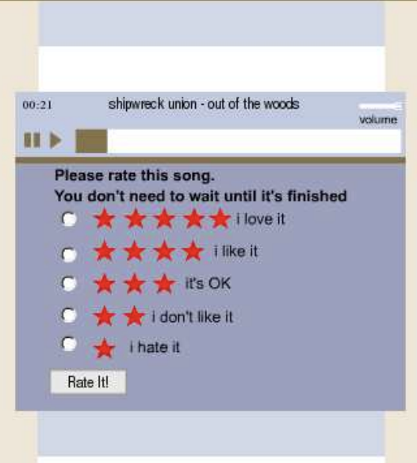
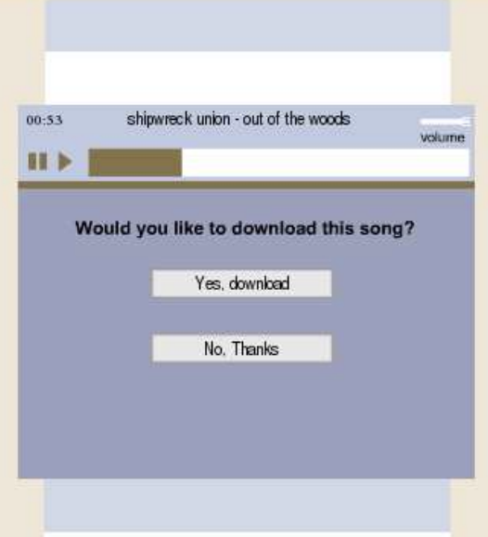
Music Lab outcome measurement
DV: rating and download

Slide 15
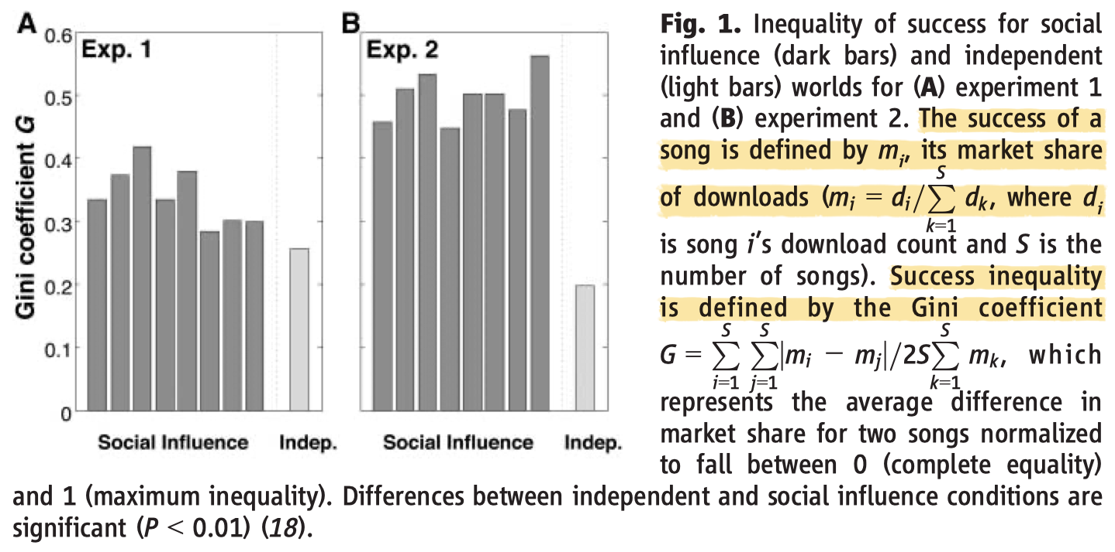
Music Lab experimental findings
Social influence creates inequality in cultural markets
(they even ran a 2nd experiment due to the zero-cost design)

Slide 16
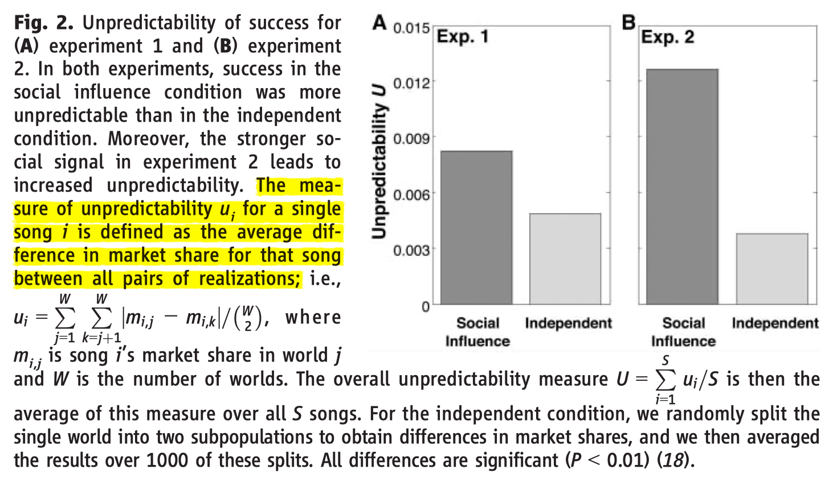
Music Lab experimental findings
Social influence creates unpredictability in cultural markets
In the 2nd exp, songs are ordered by their download counts (shows a stronger signal for social influence)
Notes:
Pairwise difference in 8 worlds (not std.)

Slide 17
Issues for two research designs
Observational: large scale but suffers from confounding and selection biases, weak in causality, cheap (data & code)
Experimental: strong in causal claims and mechanisms but lacks generalizability, time consuming and costly (field exp)
Best practices: combine both designs
Obs: Use diverse datasets, open data/code, causal inference
Exp: pre-registration, replication (rounds), power analysis, ethics

Slide 18
Summary
Research design = the most important decision you make
Observational studies → great for description & exploration
Experiments → causal claims & understanding mechanisms
CSS makes them easier than ever
Large open empirical datasets, open-sourced statistical models
Digital platforms for recruiting participants / performing tasks

Slide 19
Learning objectives
Define online communities, ontrast with offline ones
Explain key patterns in user participation, evolution
Community norms, adoption
Predicting growth and success
Core techniques for analyzing communities

Slide 20
What are online communities
Digital spaces for interaction, identity formation, shared norms
Key features: persistence, searchability, scalability, algorithmic mediation
Types of communities:
Interest-based (subreddits, wechat groups)
Identity/support-based (mental health forums, LGBTQ+ groups)
Professional (LinkedIn networks)
Ephemeral/emergent (hashtag-based social movements such as #BLM)

Slide 21
Online vs. offline communities
Key differences:
Scale: millions vs hundreds
Superficial vs. meaningful interactions
Virtual vs. in-person
Anonymity/pseudonymity
Asynchronous + persistent traces
Algorithmic curation shapes visibility

Slide 22
User behaviors
Patterns of platform engagement:
Lurking vs active participation
Various motivations:
information seeking
social validation
self-expression
belonging
entertainment
Dark behaviors: trolling, toxicity, harassment
Platform design shapes how user behave
Upvotes / likes (hidden or revealed)
Retweets (enabled or disallowed)
Anonymity (FB vs. Telegram)
Rewards (badges)

Slide 23
Participation Inequality
The 90-9-1 Rule:
90% lurkers (never contribute)
9% occasional contributors
1% users create most content
Variations:
Wikipedia: ~99.8–0.2–0.003
Blogs (vlogs): 95–5–0.1
Examples?
Notes:
Instagram

Slide 24
Evidence of 90-9-1 rule
Common observations:
Reddit: Majority users only read; small % post/upvote heavily
Wikipedia: ~0.003% most active editors do ~2/3 of work
Twitter/X: Power-law distribution in tweet volume
Why it persists:
Barriers (time, resource)
Free-rider problem
Implications:
Small core drives norms & culture
Platform incentives can shift ratios (gamification, moderation)
Notes:
Instagram

Slide 25
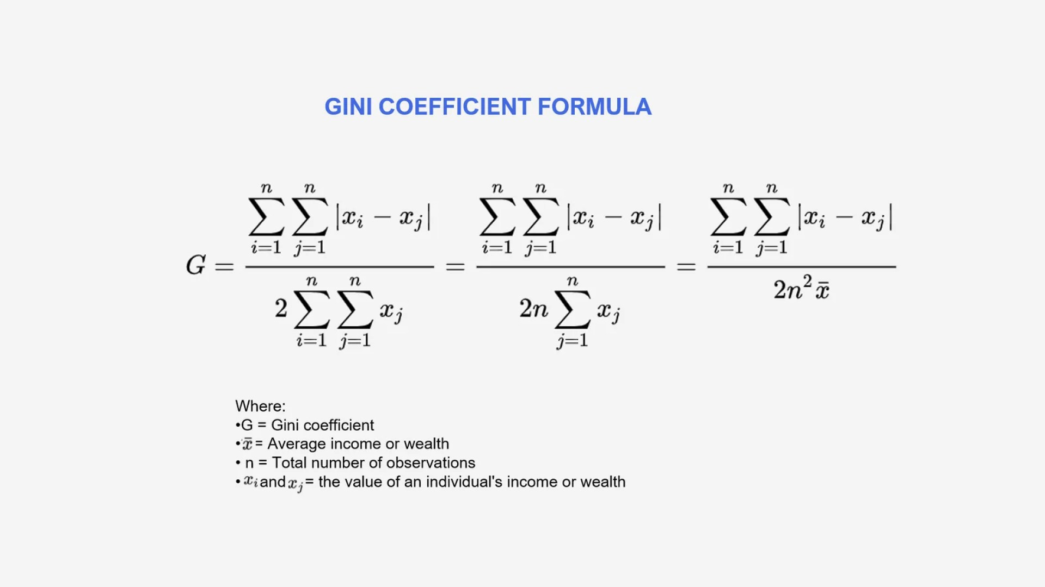
Gini index of inequality
https://penpoin.com/gini-coefficient/
Notes:
Instagram

Slide 26
Measure of inequality/centralization
Gini coefficient based on user activity level:
Wikipedia article: distribution of the num. of edits/revisions per editor
Github repository: dist. of the num. of commits per developer
Reddit group: dist. of the num. of posts/comments per member
Performance metrics:
Wikipedia: the article being promoted to Featured Article (FA Status)
Github: the num. of stars/forks
Reddit: the subreddit size grows by +50% within X months
Is activity centralization predictive of crowd performance?
How do we design a study to examine this question?
Notes:
Instagram

Slide 27
Measure of polarization
Opinion based polarization:
Wikipedia article:
Compute the ideology score for each editor based on their relative contribution to a list of conservative vs. liberal wiki articles.
Calculate the variance of ideology scores for each article.
Reddit community:
Aggregate posts and comments for each user, create word2vec or doc2vec embedding per user, or use BoW / TF-IDF vectors.
Compute average pairwise cosine distance.
Network (interaction) based polarization
Notes:
Instagram

Slide 28
Power of polarized crowds
Polarization helps create echo-chamber effects
But is polarization necessarily bad?
An interesting research question:
Is polarization correlated with community success on Reddit?
What is the IV and DV?
How to measure them?
What are control variables we need to consider?
Notes:
r/CompSocial

Slide 29
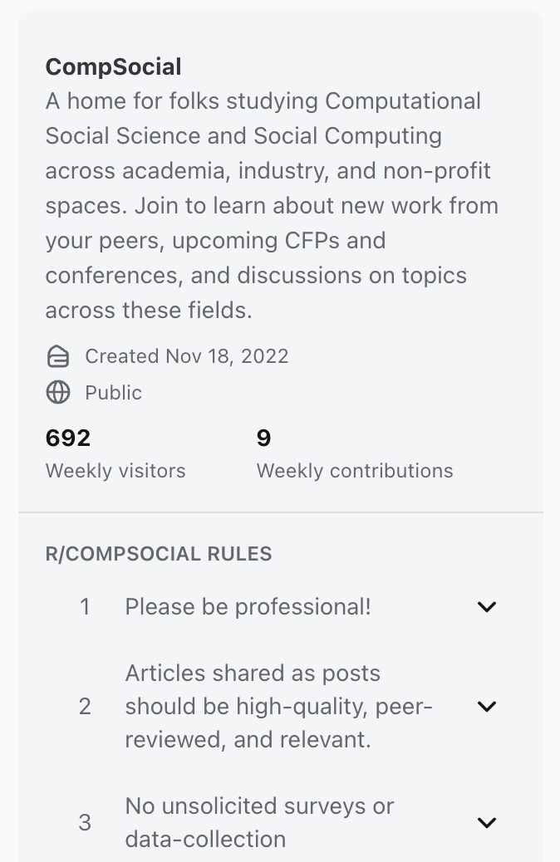
Community norms
What are they?
Unwritten/shared rules guiding behavior (e.g., no toxicity, cite sources)
Emerge from repeated interactions & moderation
Stronger in close-knit vs. large anonymous spaces
Formation of norms
Through user interactions & feedback
Norms evolve from conflicts/resolutions
Role of early members & critical mass
Notes:
r/CompSocial

Slide 30
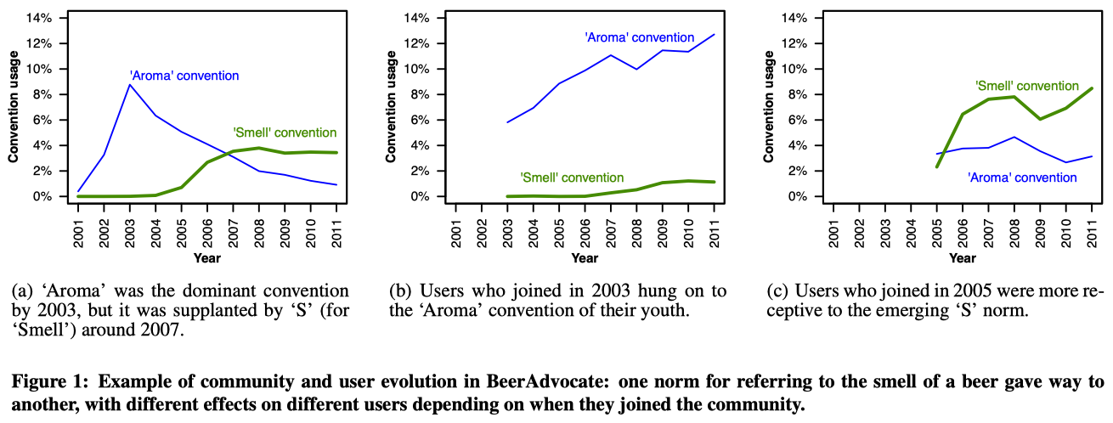
Linguistic norms on Reddit
There are linguistic norms in online communities, which is evolving.
New users often adapt to current norms upon joining a community.
As they get older, they become “lazy” to sync with new norms/rules.
Cristian et al. User lifecycle & linguistic change in online communities. WWW. 2013.

Slide 31
User roles & trajectories
Common life-cycle of individual users:
Newbie → regular → power user → moderator
Competition from other platforms
Onboarding challenges & churn risks
Behavioral lifecycle:
lurker → commenter → poster
Notes:
Instagram

Slide 32
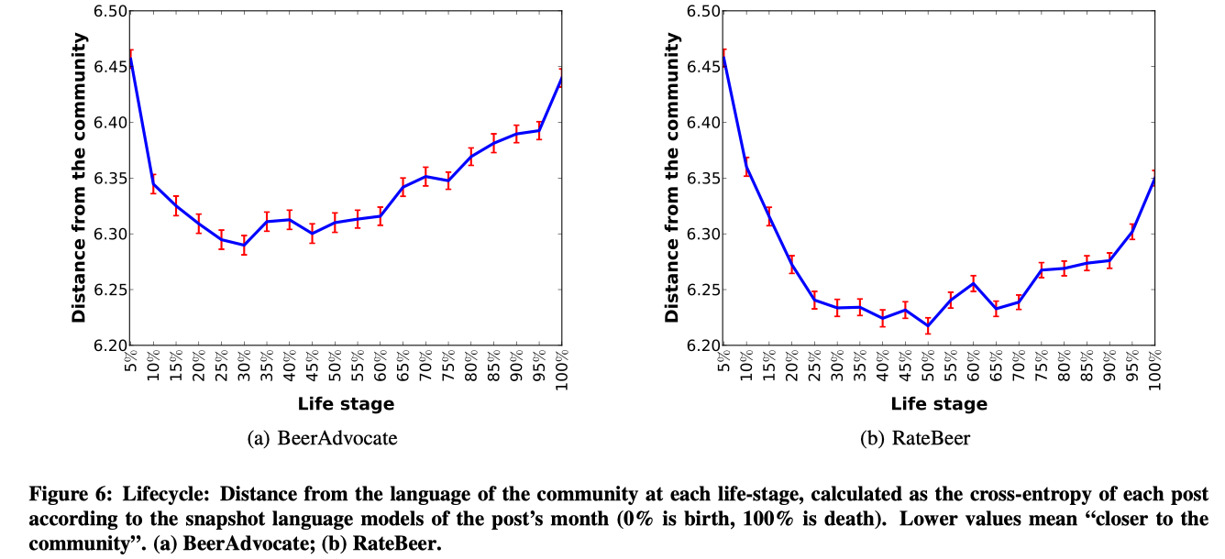
Evidence of user lifecycle
A two-stage lifecycle of user susceptibility to linguistic norm change:
Learning phase (1/3): users learn community’s innovative language
Conservative phase (2/3): users stop tuning with evolving norms
Notes:
Linguistic norms are always changing in online communities
Users leave when old conventions conflict with new norms

Slide 33
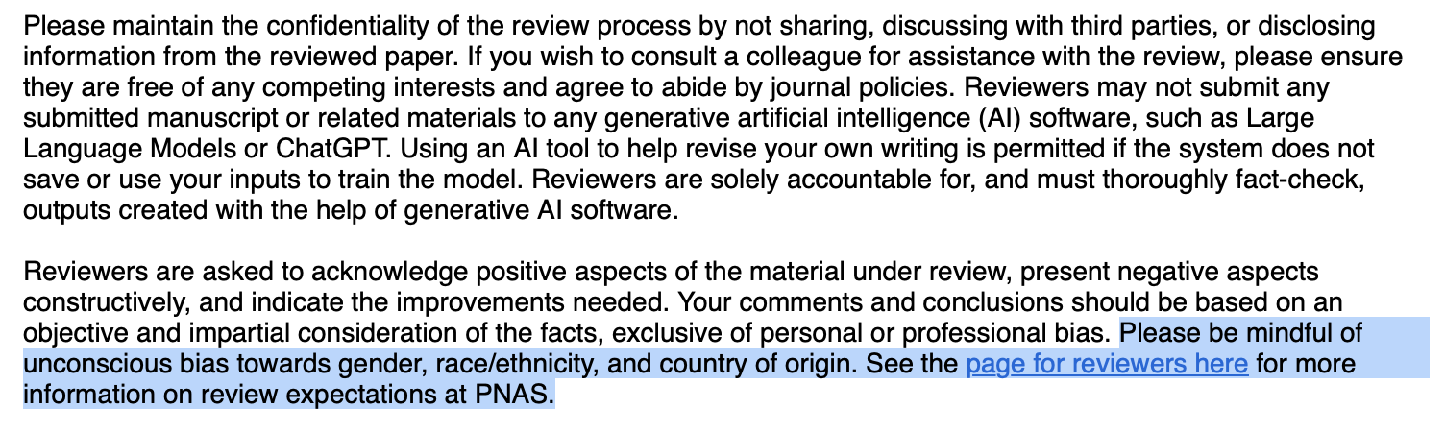
Impact of norms on behavior
Explicit rules increase newcomer compliance & participation
Display expectations reduces biases, boosts equality & equity
Notes:
r/CompSocial

Slide 34
User adoption & churn
Adoption
The behavior of starting to use a specific word, phrase, hashtag, image, etc.
It could simply mean joining an online community such as a subreddit.
Churn
User abandonment (stop activity)
Types: hard (immediate exit), soft (gradual decline)
Why it matters?
Retention for building healthy communities
Preventing churn means growth and success
How can we better predict user retention?
Notes:
r/CompSocial

Slide 35
Churn prediction
Some challenges and insights:
Class imbalance, heterogeneous reactions
Lack of generalizability across communities
Many features can differ across different platforms
Can we leverage linguistic signals of intent to leave?
Notes:
r/CompSocial

Slide 36
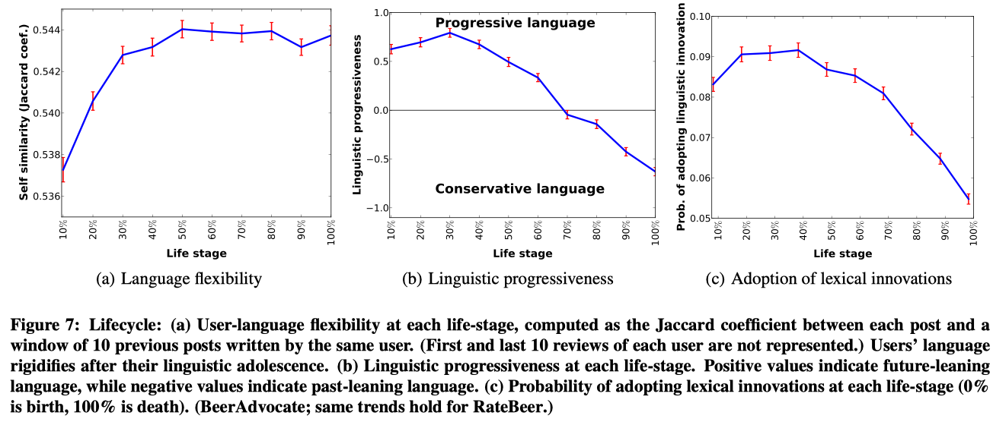
User linguistic change
Adolescent users learn and adapt to new and progressive language.
Senior users stop conforming and drift away from latest trends.
Can we leverage these patterns/features to predict user retention?
Notes:
Compare the target post to all posts during 2y period (one year before and one year after) by computing H(p,SLM i ), the cross-entropy of p with respect to the SLM i language model.
Under this notation, Prog(p) = −3 would mean that the language of the post p appears to closest to the language used in the third month before p was written.
A lexical innovation is a word that was never used before in the community and that was used at least 10 times by multiple users in posts discussing different products over a period of 6 months after the word was ﬁrst used.

Slide 37
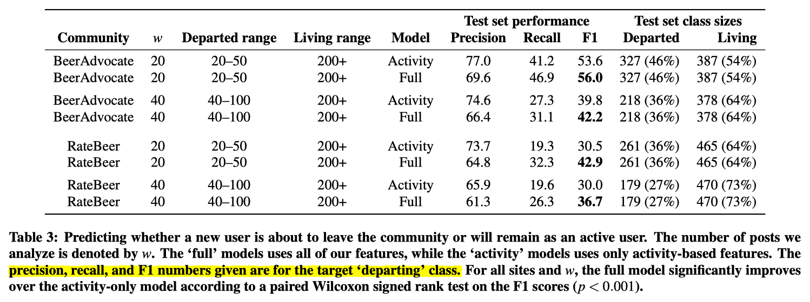
Churn prediction using linguistic change
Using first w posts to predict churn or retention (logit):
Departed: users who left before writing m more posts (e.g. [20, 20+30]).
Stayed: users who stayed long enough to write >= 200 posts in total.
The w posts could be early stage for some users but be later for others. The idea is that we can use language features to distinguish the two types & predict retention.
Notes:
The task ignores middle users in the range [50, 200] because their staying status is uncertain.

Slide 38
Community growth & success
Multi-faceted metrics for success:
Member size growth within a time window
Percentage of users retained within a year
Long term survival (e.g., still active after two years)
Volume of activities (e.g., avg. num. of posts per month)
Crowd performance metrics, Content quality
In practice:
Not one-size-fits-all: different communities succeed differently
Desirable: Sustained growth + low churn + quality interaction
Notes:
Growth and retention are related but not the same

Slide 39
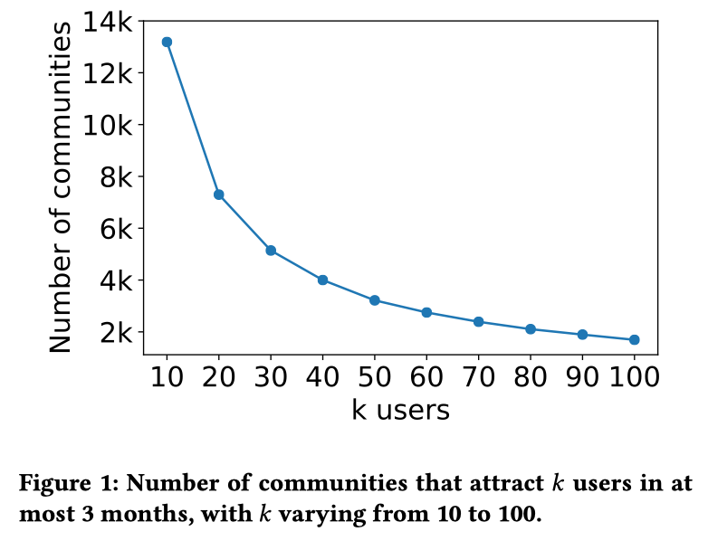
Most communities grow a little
Cunha et al. Characterizing and Predicting the Success of Online Communities. WWW, 2019

Slide 40
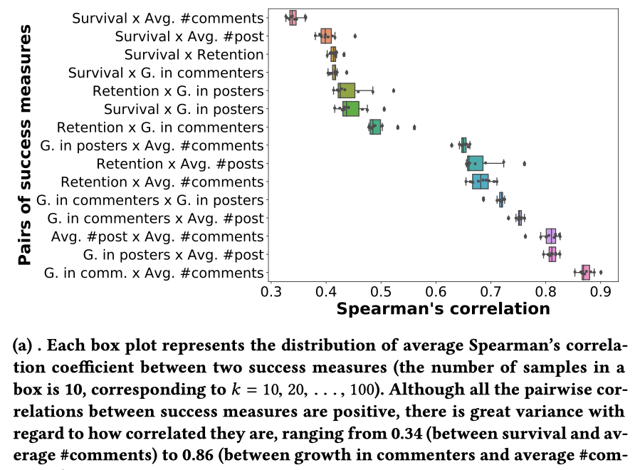
Growth metrics are correlated
Do a measurement of each metric when a community reaches k users.
Notes:
They compute a correlation for each pair of metrics for each k.
K means taking a snapshot of a community when it reaches k users.
There are 10 correlation values.

Slide 41
Useful features
Volume, speed, and concentration of activity
Participation rate and equality may help
Fraction of posts and comments that received at least one reply
Network structure and member interactions
Composition of new and old (experienced) users
Build a comment network: compute clustering coefficient, network density, fraction of users in the largest component, avg distance, etc.
Linguistic patterns
Avg./median length of posts, comments
Size of vocabulary, unique words
Distribution of LIWC categories
Distribution of Big Five personality traits
Toxicity, incivility, harassment
Example: Predicting success of Reddit communities
Notes:
Balanced participation

Slide 42
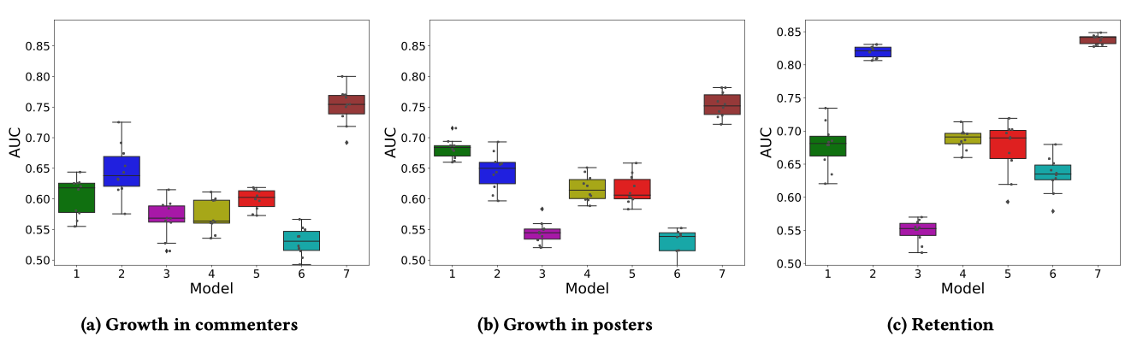
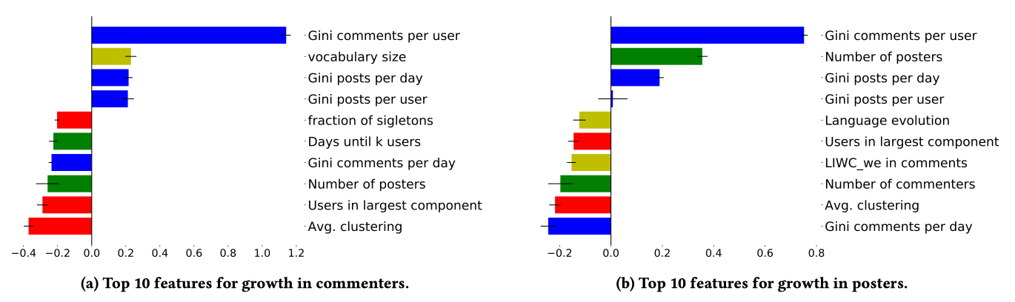
Predicting future success from past

Slide 43
Crowd behavior under shocks

Slide 44
Course notes
HW2 released
Due in two weeks (before class time)
Research Proposal
Due next week on Mar 9
Presentation slides due before class on Mar 30
Be mindful of timing (about 15 minutes per team)
Final report due on April 13
Causal Inference next week

